Slide 1

Washington, DC and Neighborhood Diversity
Joseph Lavicka

Slide 2
Introduction
Washington, DC
Many diverse neighborhoods
Wide variety of cultural and economic activity

Slide 3
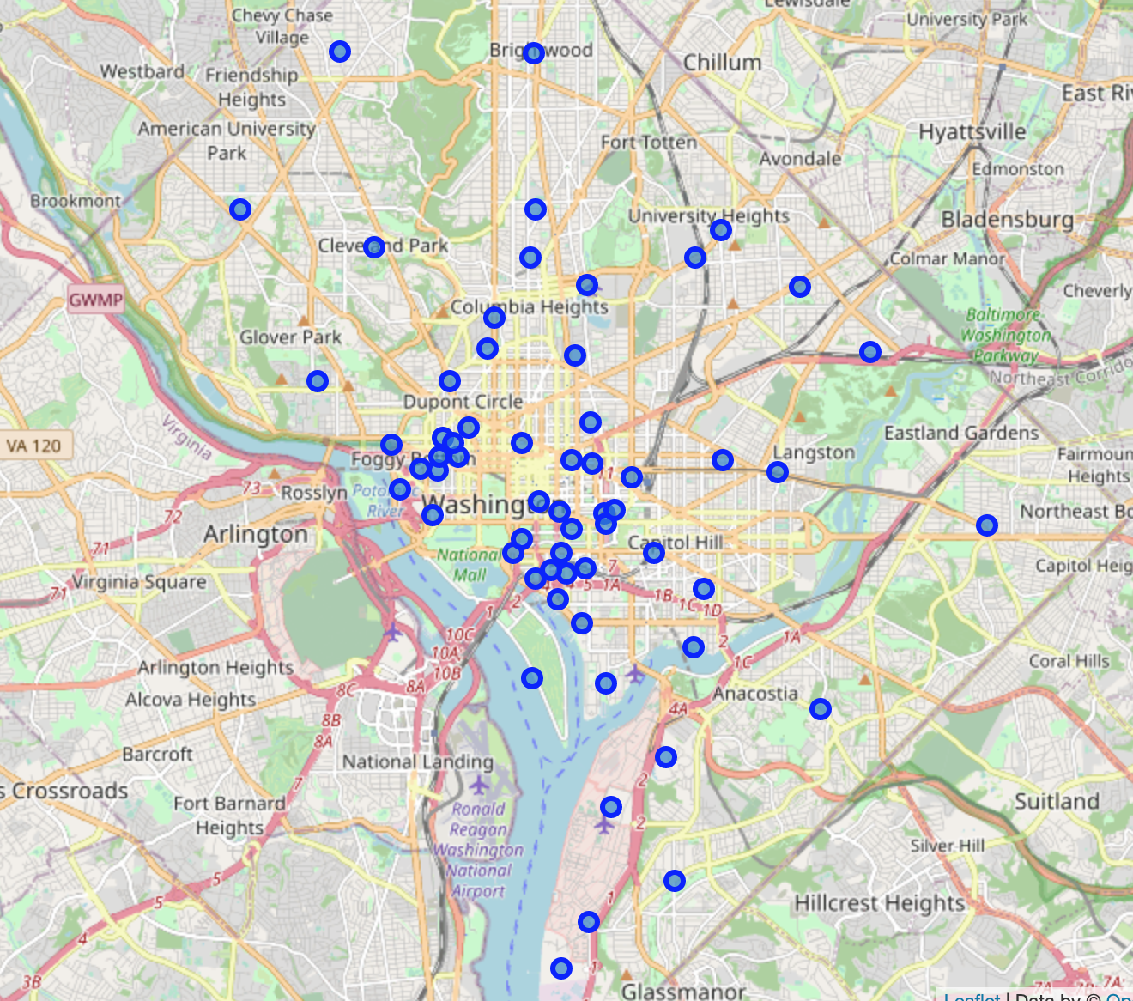
Data
Foursquare location data
61 Zip Codes
383 unique venue types

Slide 4
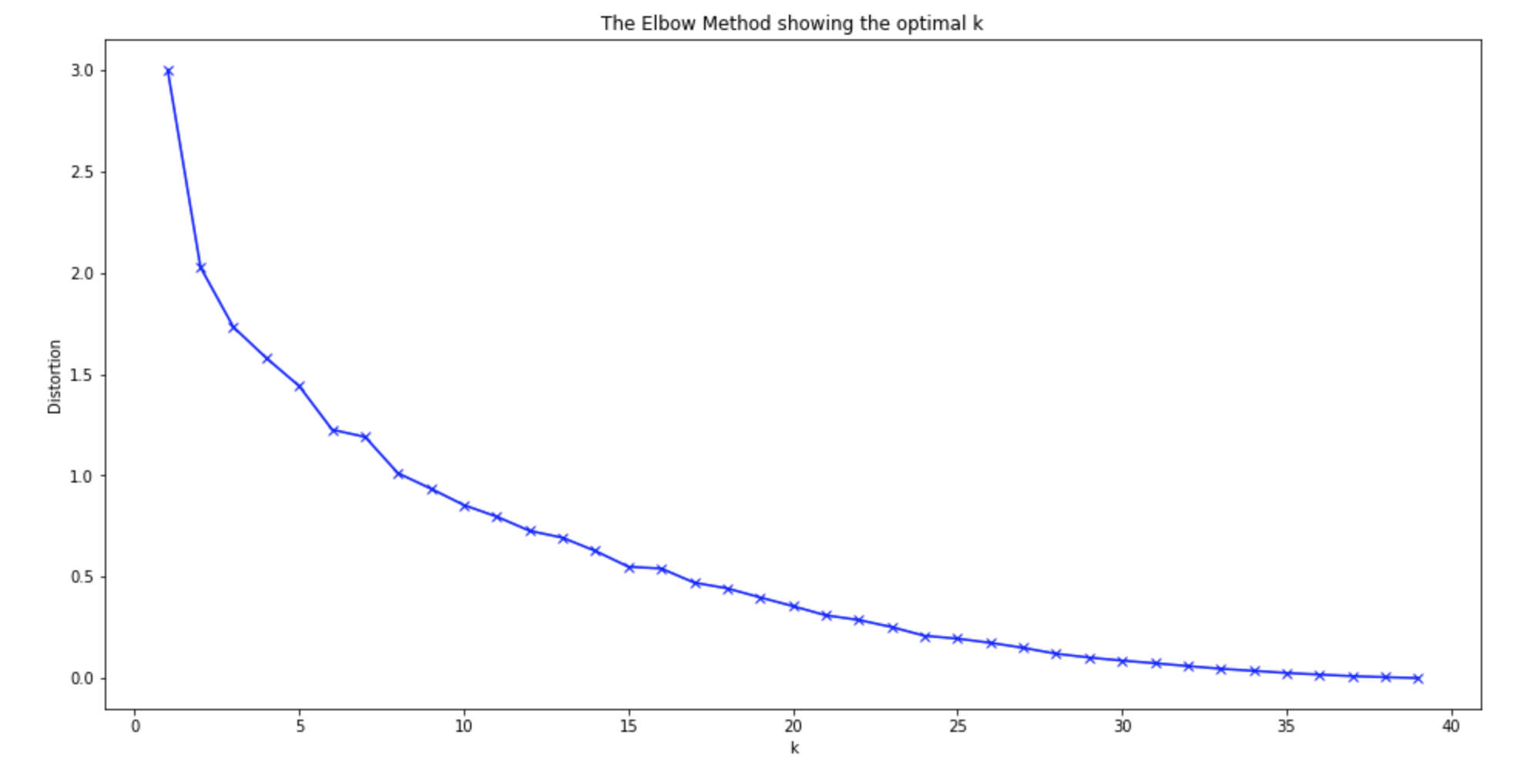
Methodology
K-means cluster analysis
Elbow Method

Slide 5
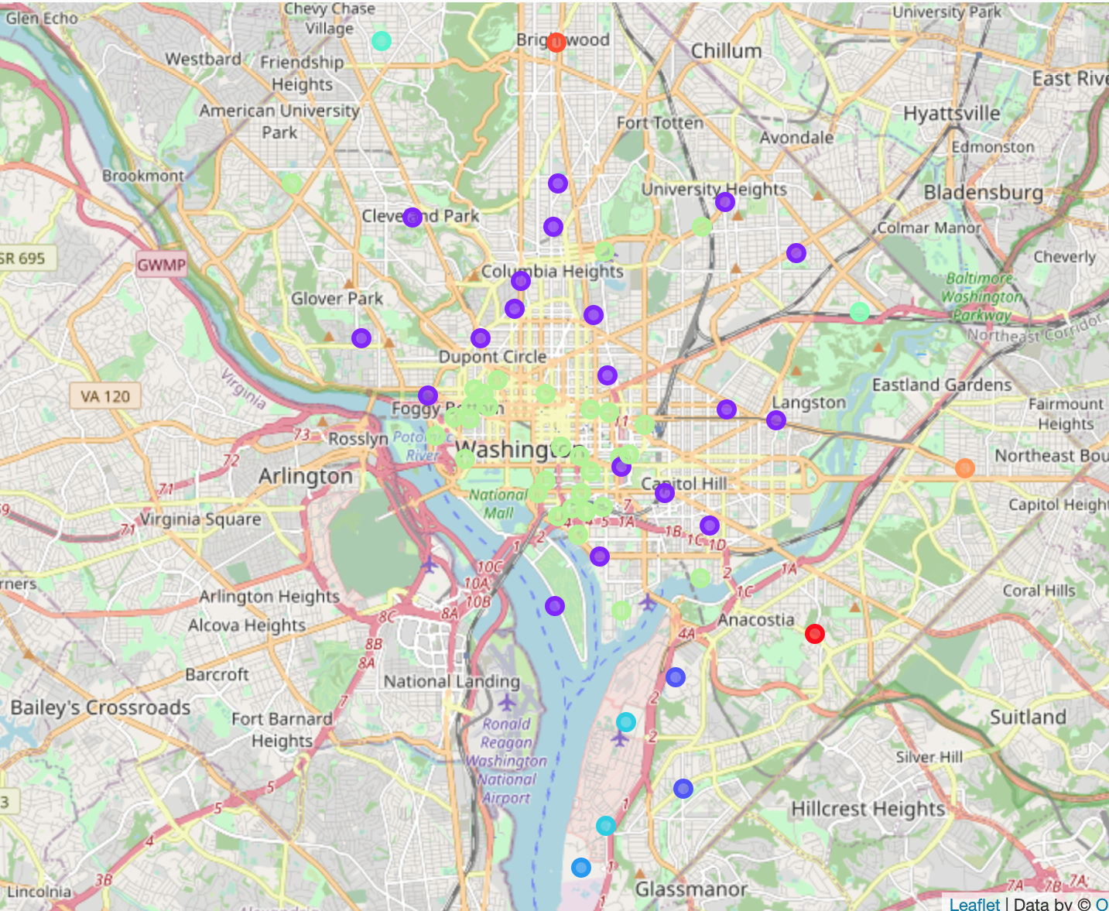
Results
11 different clusters
Cluster 1 and Cluster 7 are two largest

Slide 6
Discussion
Heterogeneity across neighborhoods east of the Anacostia River
Homogeneity across neighborhoods surrounding downtown DC

Slide 7

Questions

